Slide 1

KDRAFT
IBM HACK-CHALLENGE 2023

Slide 2

0
OVERVIEW
0
TIMELINE
0
WEB-BASED PROJECT
0
EXISTING PROBLEM
CONTENTS
0
SOLUTION

Slide 3

OUTLINE
Our K-Drama Movie Analytics website is your hub for all things K-Drama. Explore our extensive K-Drama database, dive into insightful analytics, and stay updated with the latest industry news. Whether you're a seasoned fan or new to K-Dramas, we've got you covered.

Slide 4
TIMELINE
한국 드라마
|-JUN/21 - REGITERED FOR HACKCHALLENGE
|-JUL/28 - COMPLETION OF BOOTCAMP 02
|-JUL/21 - IDEA SUBMISSION FOR PROJECT
|-AUG/07 - STARTED FRONTEND
|-AUG/10 - STATERD COGNOS ANALYSIS
|-AUG/21 – STATERD BACKEND
|-AUG/30 - COMPLETED PROJECT

Slide 5
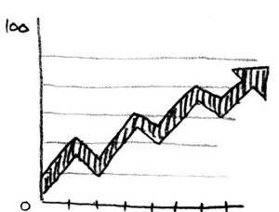
WEB BASED
DATA PROJECT
Our Analytics project provides users with comprehensive data which assists them in evaluating about data about k-drama that are best for them.

Slide 6

PROBLEM FACED
In entertainment data analytics, notably for K-Dramas, challenges persist in ensuring strong data privacy amid growing data volumes, improving data quality, mitigating potential biases, and harmonizing monetization with user experience. Successfully addressing these issues is pivotal for sustaining industry growth and delivering valuable insights to users.

Slide 7

PROPOSED SOLUTION
To overcome challenges in KDrama analytics, prioritize data privacy and quality, employ bias-mitigation techniques, and strike a balance between monetization and user experience. Continuous user engagement and adherence to regulatory standards are also crucial for long-term success in this dynamic industry.

Slide 8

01
IBM COGNOS
02
JAVA SCRIPT
03
HTML
04
DJANGO
PLATFORMES USED

